Slide 1
Advanced Software Engineering processes - Assignments
House of Quality
Testing
Code Review
Code Refactoring

Slide 2
House Of Quality - HOQ
Brief overview of what house of quality is.
A diagram resembling a house used to correlate customer desires to product capabilities.
HOQ is part of Quality function deployment, a planning matrix to relate what the customer wants to how the firm that produces products will handle these wants.

Slide 3
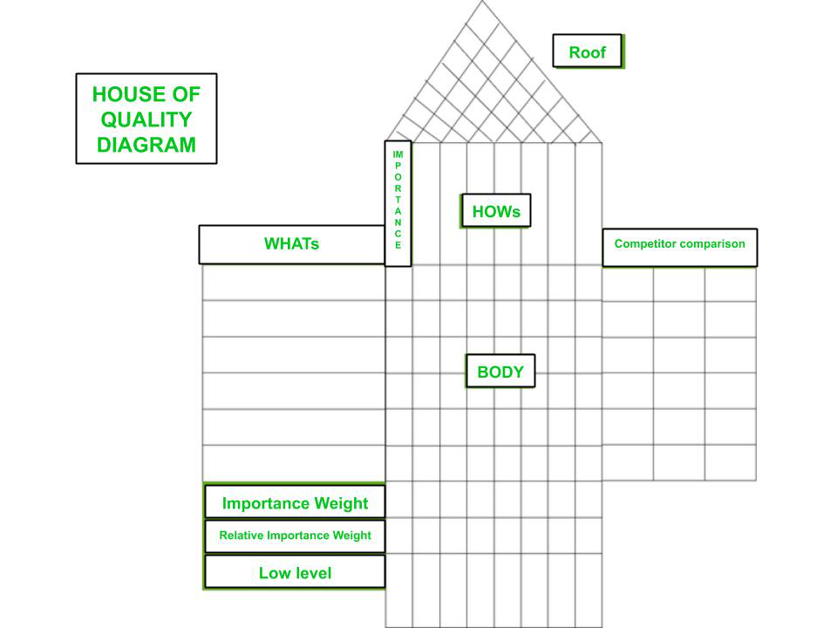

Slide 4
Beefed Rolex HOQ

Slide 5
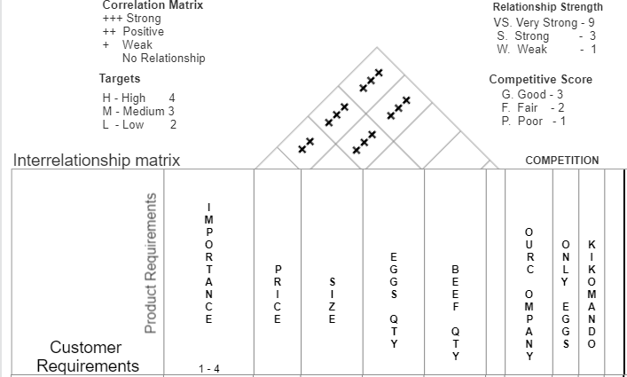

Slide 6
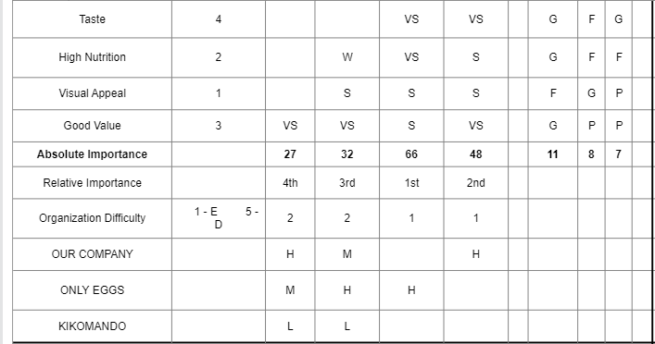
Price
Size
Eggs
Beef
5 -
TARGETS
H

Slide 7
Steps involved in Constructing a Beefed Rolex HOQ
Recording voice of the customer(their wants or needs)
Ranking the importance
Translate customer wants into the technical descriptors
Examine relationships between design between design and the customer requirements.
Ranking what is important in terms of Design
Look at relationships in design requirement themselves
Customer rating of competitors(their perception of us to our product)
Organizational difficulties on delivering required product.
Recording targets with technical evaluation of the competitors.

Slide 8
What I have learnt out of HOQ
Customers play a vital role in requirements engineering
The HOQ designing can be time consuming but it is so helpful
HOQ helps in prioritizing requirements.
Guides in mapping customer wants to technical capabilities
Helps to understand the competitors and how to edge them.

Slide 9
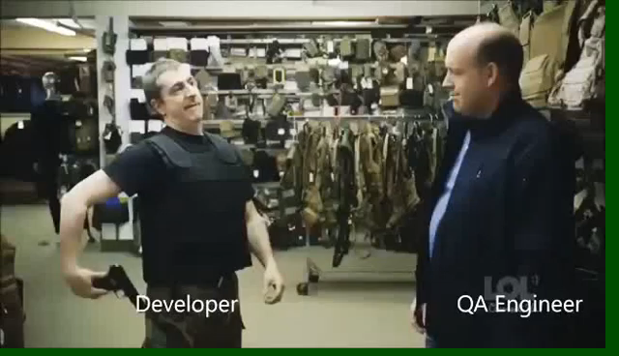

Slide 10
TESTING
Aim: To select an application and perform testing techniques over it using selenium as a testing tool.
Application Selected: E-Commerce Platform
Software type: Web Application.
Features of Testing-Shop include Newsletter, Email, Inventory, Payment Gateways, and Shipping etc.
Built on: Django (Python web based framework)

Slide 11
Software Testing Tools selected:
Functional Testing Tool: Selenium
Types of testing we intend to do:
Functional Tests:
Unit Testing
Black Box Testing
Non-Functional Tests:
Load Testing
Stress Testing

Slide 12
Test Plan
The objective of the testing is to find as many software defects as possible, or ensure that the software under test is bug free.
Login and Security
1. Check the login capability
Page Display
1. Check if the pages are displayed correctly.
2. Detect dead hyperlinks , plugin dependencies, font sizing etc
4. Check if runtime error messages are displayed correctly.
5. Check if alerts are displayed whenever required

Slide 13
Usability
1. Check if the design is non intuitive.
2. Check if the site navigation is poor.
3. Check if help-support feature is poor.
4. Check if catalog navigation for the customer is not proper.
Shopping order processing and purchasing
1. Check if the shopping cart functionality works properly.
2. Check if the order processing happens as desired.
3. Check if payment processing works properly.
4. Check if the order tracking feature is proper.

Slide 14
OUT OF SCOPE
The following features were not tested due to lack of enough time and resources.
Session Testing e.g timeouts
Content Analysis such as misleading pages
Availability test e.g DOS
Back-up and Recovery Testing, how each component will react when the server is down
Performance Testing, check for scalability of the application

Slide 15
Out comes of the tests
All the 100 tests performed according to the test plan, passed the tests.
This shows that the application works or functions as desired.
But there is need to add adjust in test planning to include the tests that were not done such as performance and availability which are so crucial for an ecommerce application.

